Slide 1

Using Face Recognition As Attendance System
Team – A6
Under The Guidance Of :
Mrs. K. Mamatha
A. Chiranjeevi (19S11A05D4)
Hari Babu K. (17S15A0502)
Arun Nayak Kansoth (18S11A0507)
Srikar Kunthala (19S11A05G8)
Team :

Slide 2
ABSTRACT
This system focuses on building a face recognition-based attendance monitoring system for educational institutions to improve and upgrade their current attendance system. The current old system has a lot of ambiguity that caused inaccurate and inefficient of attendance taking. The technology working behind will be the face recognition system. The human face is one of the natural traits that can uniquely identify an individual. Face recognition utilizes facial features for security purposes. The classification method is K-Nearest Neighbor (KNN). The K-Nearest Neighbor algorithm uses neighborhood classification as the predictive value of a good instance value. K-NN includes an instance-based learning group.

Slide 3



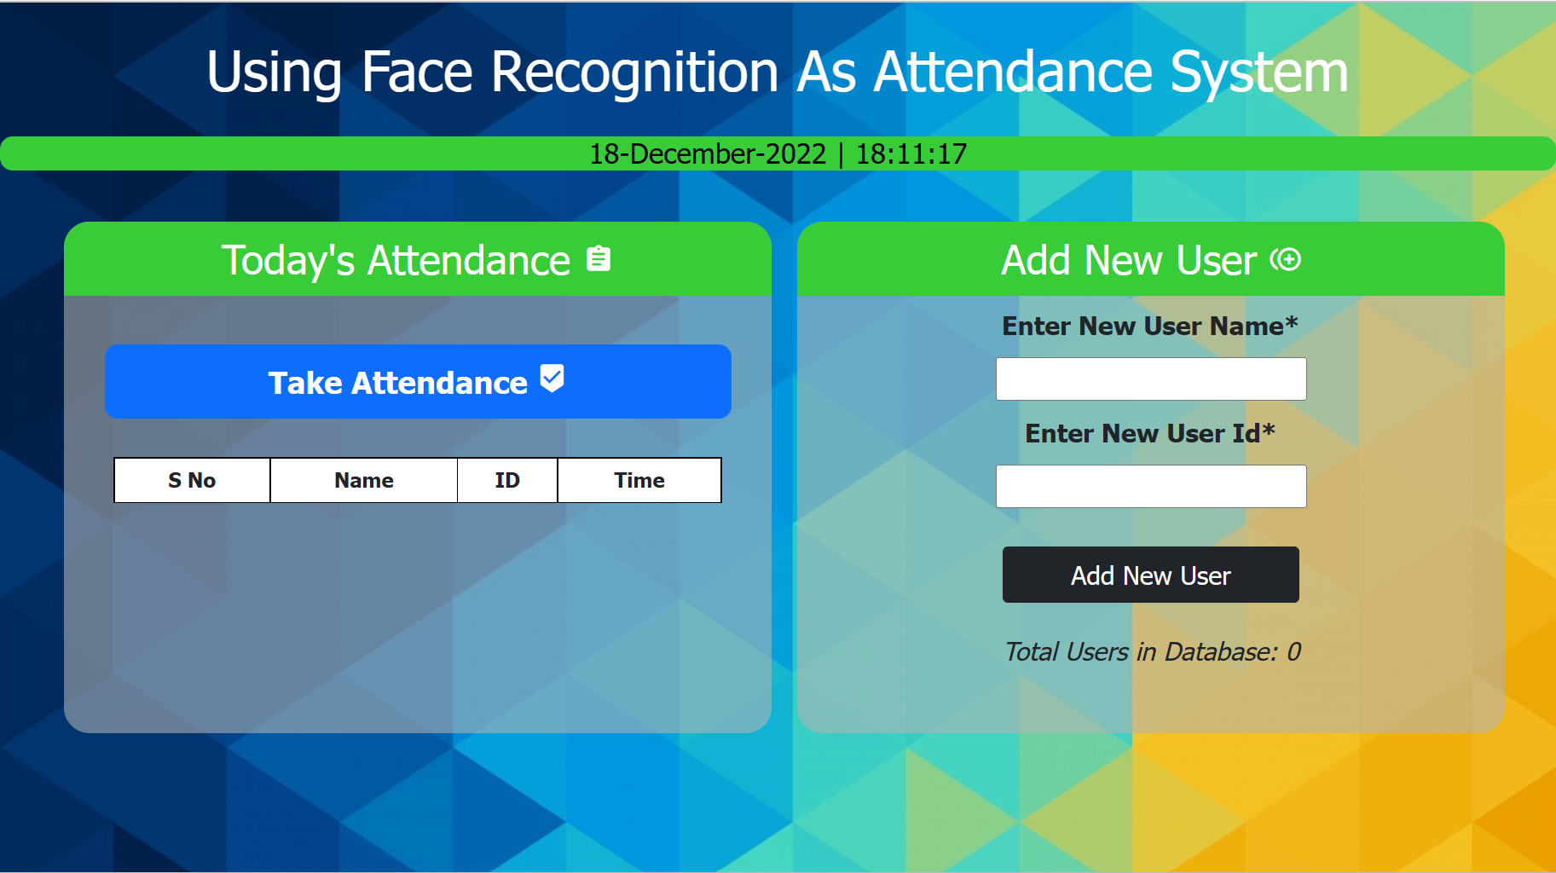
AGENDA
Existing System
Con’s In Existing System
Proposed System
Pro’s In Our System
Requirements

Slide 4
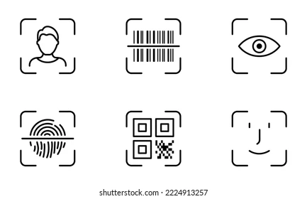
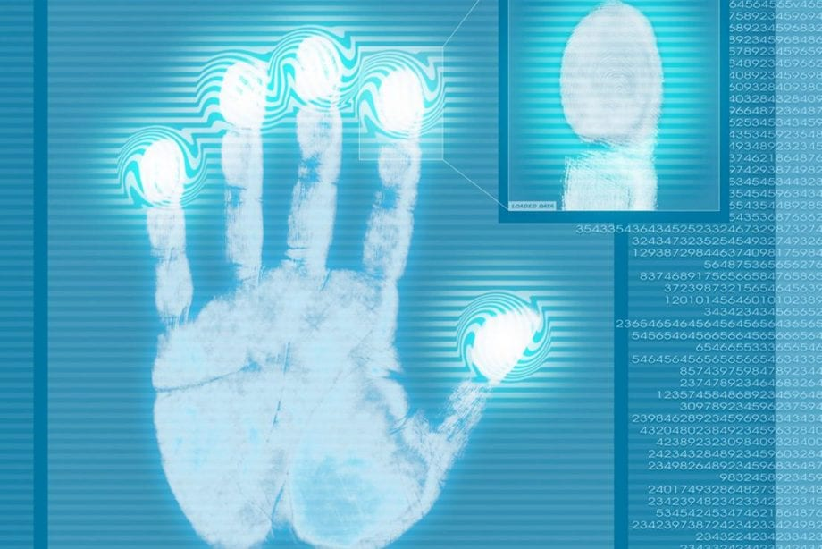
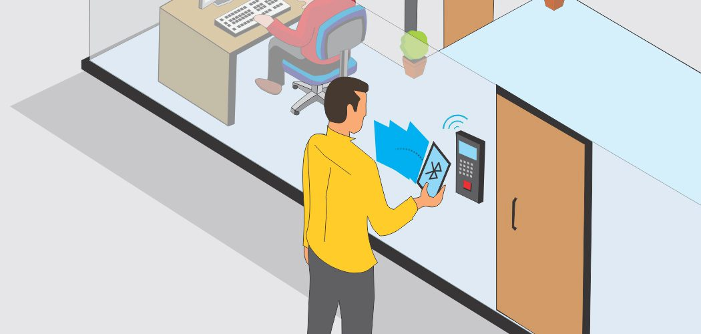
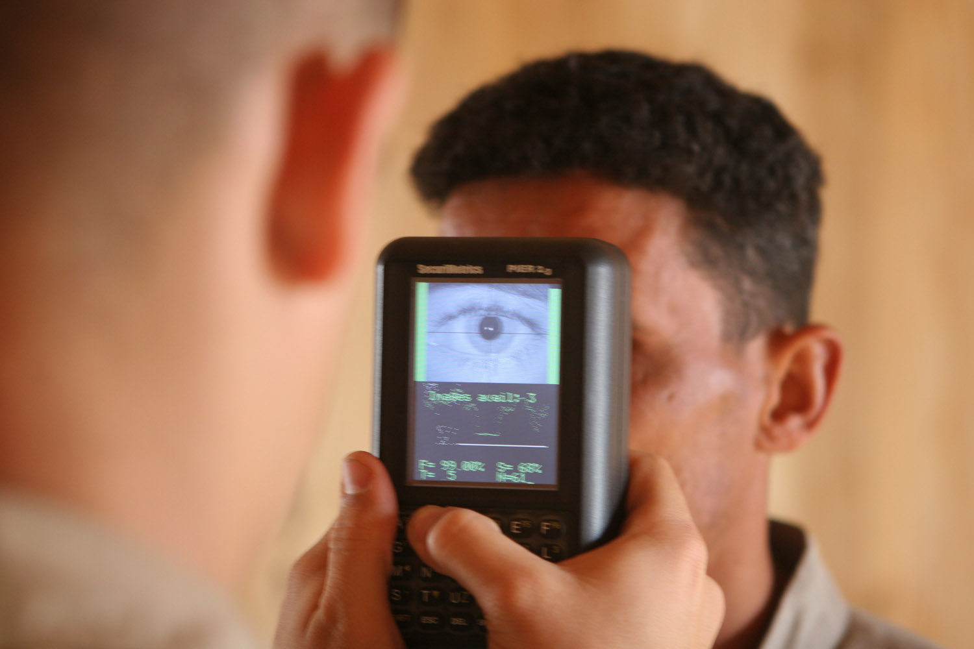
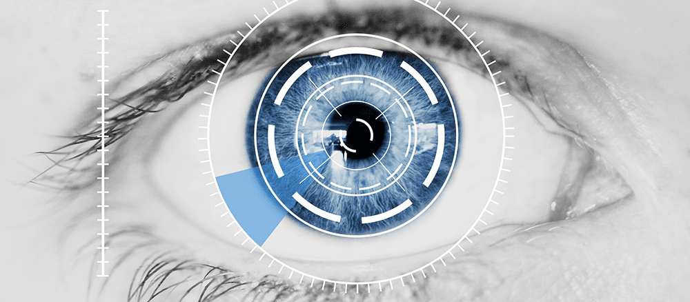
EXISTING SYSTEMS
Barcode Readers.
Fingerprint Readers.
Computerized Attendance System.
Bluetooth Based.
Iris Based.

Slide 5
CON’s IN EXISTING SYSTEM
Continued….
1. Physical Disabilities
The authentication system only recognizes traits that were entered and fail to recognize the user if their physical traits change even the slightest. Here are a few reasons why traits might change:
A burnt or damaged finger
A retina transplants
Tattooed hands
If the user is wearing lenses (and usually doesn’t) or vice versa
2. Time Consuming
For biometrics like finger print scanner it takes lot of time to scan everyone’s impressions one after another.

Slide 6
Continued….
3. Expensive on the Pocket
While the system is reliable and handy, the cost is not easy on the pocket. In biometric system the setup, integration, and hardware can be costly, especially for small businesses.
4. Scanner Issues
Some biometric systems can face scanning issues if there is even a slight change, especially if the company is using retina scanning. Iris scanning is still not 100% reliable because the system will fail if the user has long eyelashes, different eye color, or a reflection in the cornea.
5. Fake Positives
Hacking is an undying cyber theft, which means that hackers can easily manipulate stolen biometric data to create fake positives.
6. No Remote Access
In a crisis, like a security breach, HR professionals cannot access the system ‘remotely’ to try and eliminate sensitive data, which is a major disadvantage for the system.

Slide 7
PROPOSED SYSTEM
This is our system that uses the face as a biometric and fills in the attendance for the faces it recognizes.
One of the features that makes our app stand out among other face recognition apps is that it uses the latest Python version 3.11.0 (the most recent version).
More importantly, it is easy to program and implement.

Slide 8
PRO’s IN OUR PROPOSED SYSTEM
Continued….
Save time & money
Energy savings
Efficiency
More information
Better communication
Better Attendance
No paperwork is required
Business opportunities

Slide 9
REQUIREMENTS
Software Requirements :
Hardware Requirements :
CAMERA MODULE - Web Camera.
CAMERA RESOLUTION - 720p.
PROCESSOR - 2.4GHz to 3GHz.
HARD DISK - 32GB or 128GB.
RAM - 2GB to 4GB.
PROGRAMMING LANGUAGE - Python.
GUI - Flask web.
DATABASE - MySQL.
FRONTEND - HTML,CSS.
OPERATING SYSTEM - Windows, Linux.
IDE - VS Code, PyCharm.

Slide 10
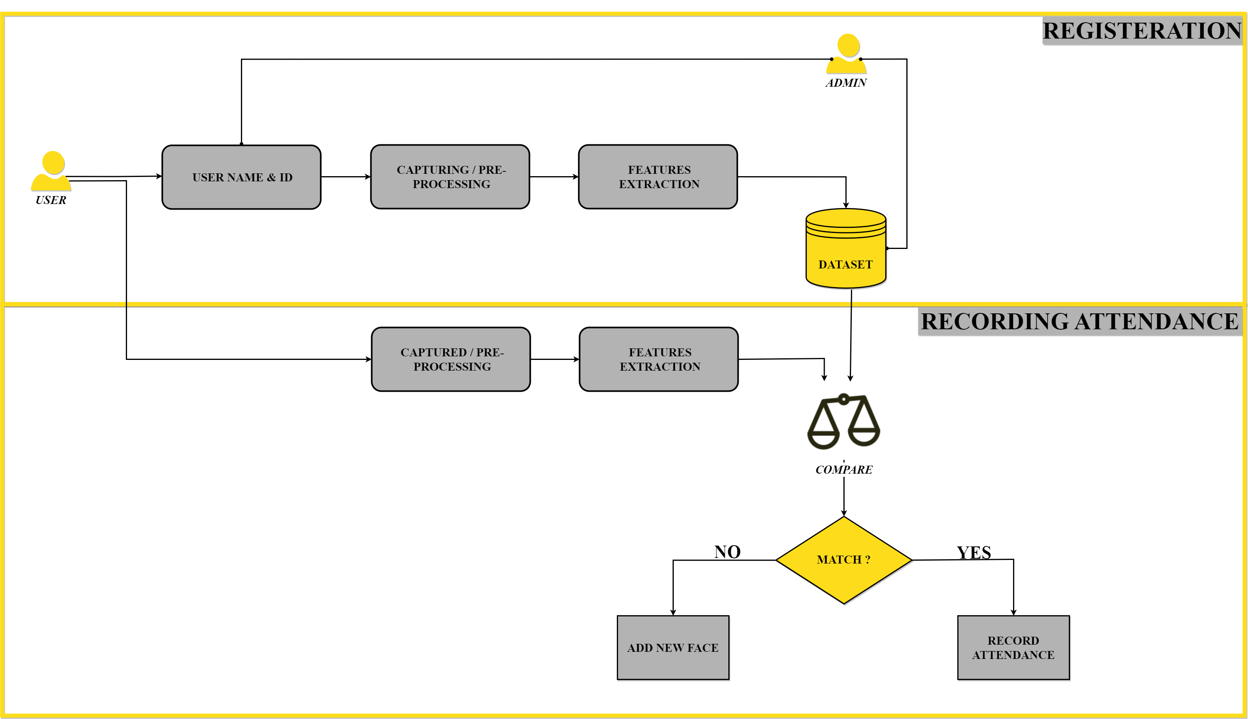
ARCHITECTURE

Slide 11
MODULES
1. User
2. Admin
3. k – NN Classifier

Slide 12
MODULE DISCRIPTION
1. USER
REGISTERATION:
User needs to register by his name and ID and as he/she clicks on add new user, it will be directed to turn on camera. The camera that is been turned on internally and scans faces, registers faces.
ATTENDANCE :
After user recording their face during registration, the user will now be able to record his/her attendance. All they need to do is to just click on take attendance button, which will turn on the camera and scans the user’s face. If it recognizes the face (by comparing scanned face with dataset face’s) it will record the attendance. If user is unrecognized (Due to not registering) it will mark the user as unknown, and requests to add new face.

Slide 13
Continued….
2. K-NN CLASSIFIER
Here in this system we are using k-NN(nearest neighbors) classifier in order to recognize the user’s face. Face recognition utilizes facial features for security purposes. The classification method is K-Nearest Neighbor (KNN). The K-Nearest Neighbor algorithm uses neighborhood classification as the predictive value of a good instance value. K-NN includes an instance-based learning group.
3. ADMIN
In this system the admin is non other than a person who is physically available to verify whether the registration done by users is legal or not. Admin gets access to all the user registered data present in dataset. To automate this process we need to enhance this system.

Slide 14
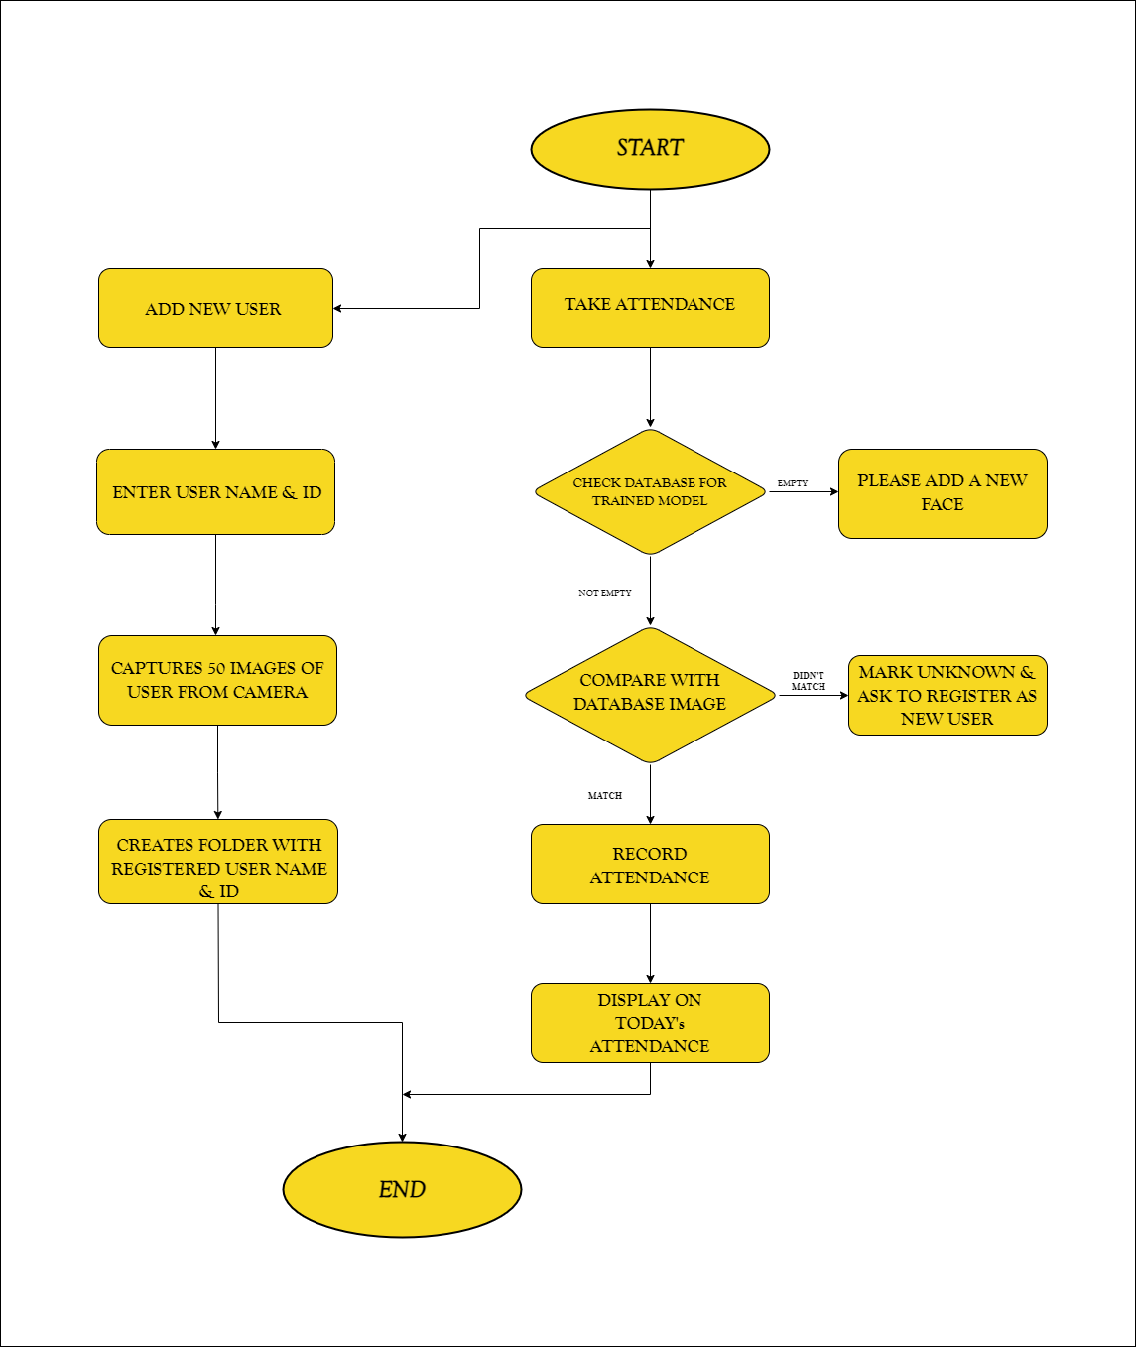
DATA FLOW DIAGRAM

Slide 15
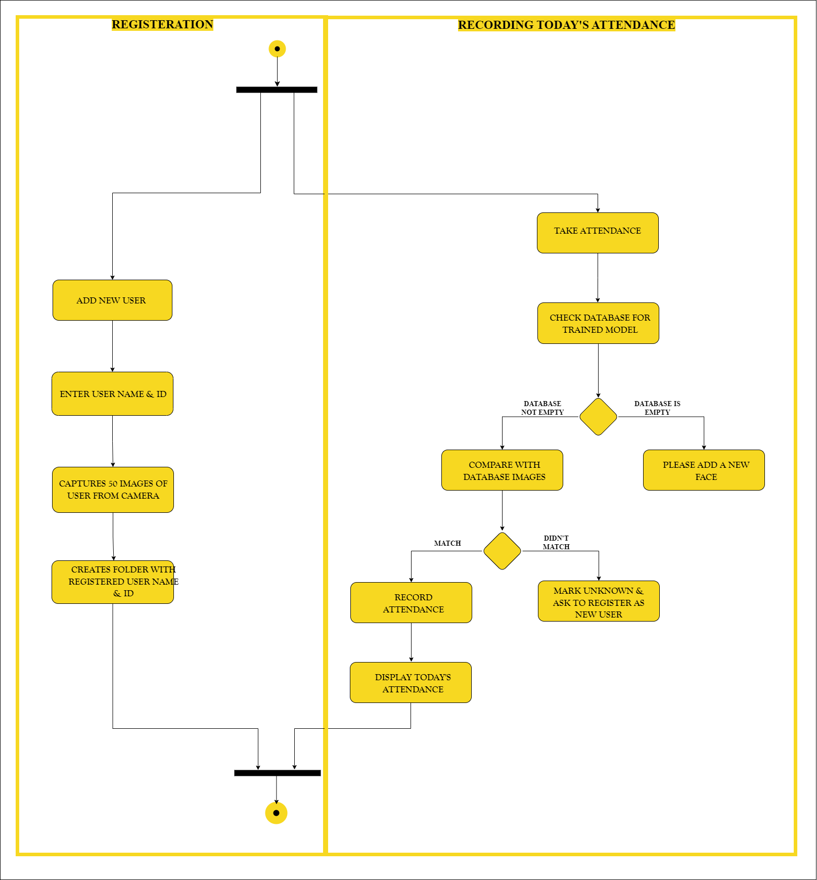
ACTIVITY DIAGRAM

Slide 16
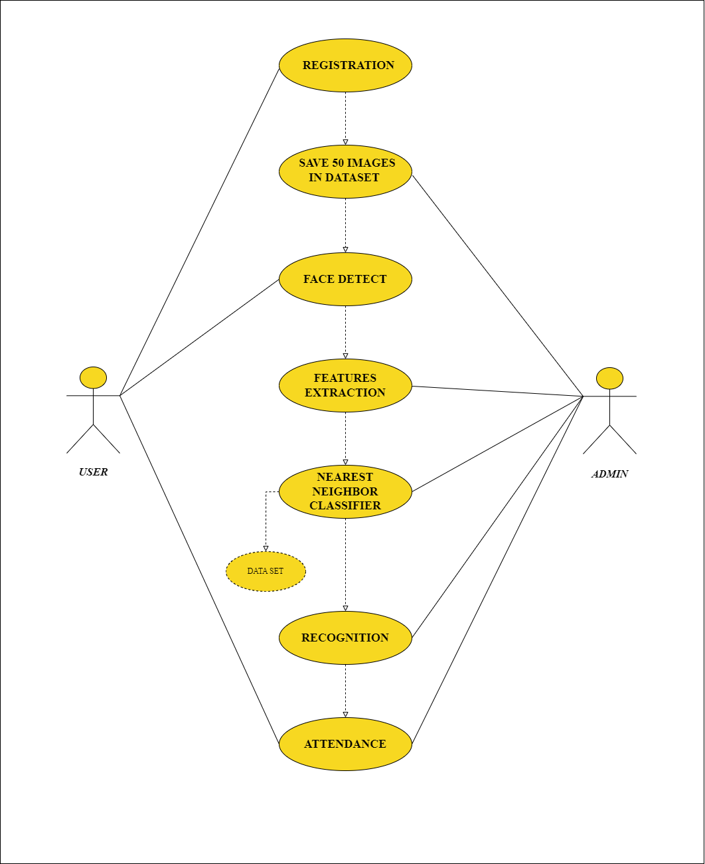
USECASE DIAGRAM

Slide 17
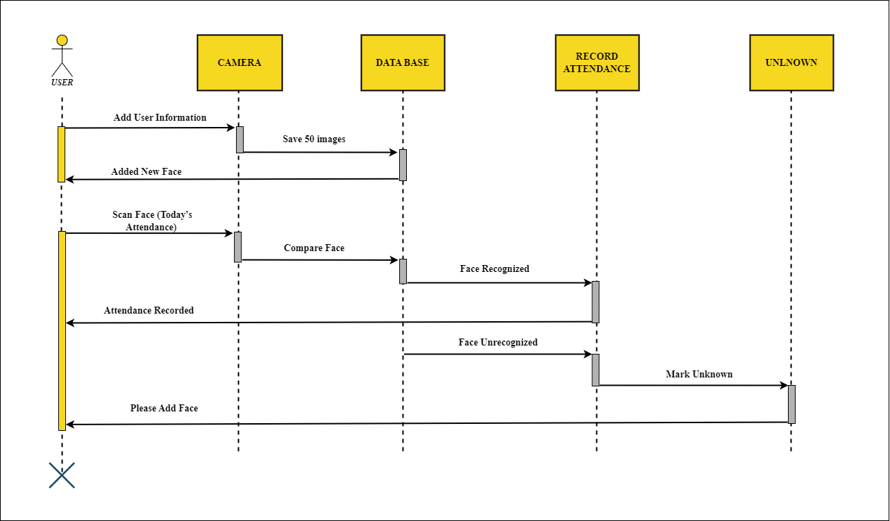
SEQUENCE DIAGRAM (USER)

Slide 18
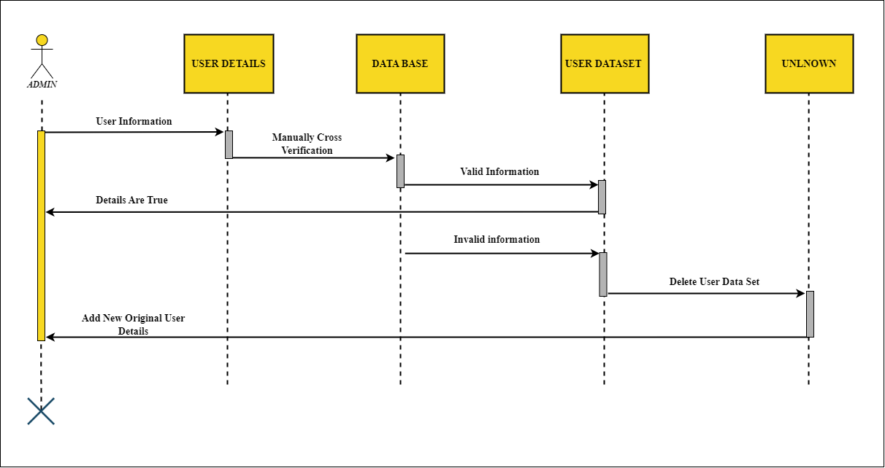
SEQUENCE DIAGRAM (ADMIN)
Continued….

Slide 19
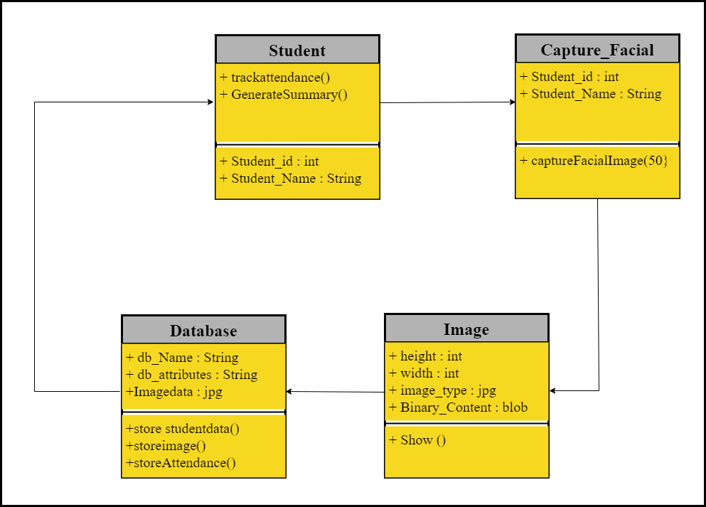
CLASS DIAGRAM

Slide 20
(“NICE MEETING YOU”)
print

